Slide 1
Blockchain on Relational and
Nosql Databases
Vedant Chauhan (892758)
Siddharth Malhotra (934336)
Saksham Agrawal (866102)

Slide 2
Goal
Here, we explore the underlying storage requirements associated with blockchain while exploring the current ecosystem of databases and form a comparative review of what would be the best architecture suited for blockchain.

Slide 3
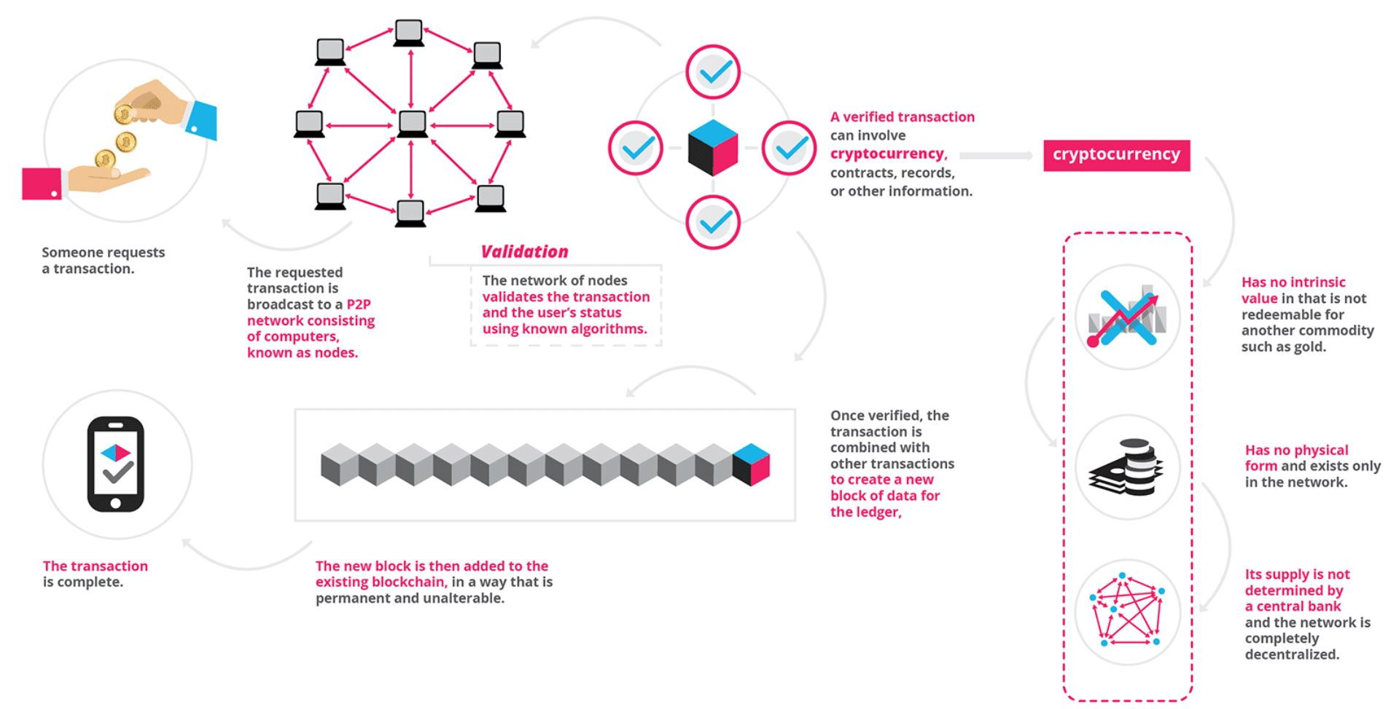
Introduction to Blockchain
Notes:
What is blockchain? A blockchain is a database which is a decentralized database which has more advantages over centralized database.
Structure of blockchain ?
It comprises of blocks, Chain, and Network.
Blocks is a list of transactions recorded into a ledger over a given period. The size, period and triggering events of block varies for every blockchain.
Chain - It’s a hash that links one block to another mathematically chaining them. This is the most difficult concept in blockchain to comprehend. SHA-256 is most common algorithm used in blockchain
Network - It is composed of all nodes. Each node contains a complete record of all the transactions that were ever recorded in that blockchain. The nodes are located all over the world and whole chain can be operated by anyone.
How it works?
When someone request the transaction, it is broadcast to a network which is Peer-to-peer consisting of computer known as nodes. The block contains all the data such as cryptocurrency, contracts, records and other information. Then the system verifies the user using algorithm. After this verification, the block is then added to the existing blockchain such that it is permanent and unalterable. Your transaction is completed.
Every transaction gets updated in the nodes all over the world.

Slide 4
Advantages and disadvantages of blockchain
Advantages
Disintermediation
Empowered users
Transparency and Immutable
Ecosystem simplification
Lower transaction cost
Faster transaction
Disadvantages
Performance
Signature verification
Consensus mechanism
Redundancy
Cost
High latency
Notes:
Advantages-------------
Disintermediation - As database is still a tangible thing which are stored in memory and disk of computer. This data can be make corrupted if someone gets the access. Due to which we give the security to third party that means great amount of time and money. However, with blockchain we can replace this third party with a distributed database, locked down by clever cryptography.
Empowered users - Users are in control of all their information and transactions.
Transparency and Immutability - Changes to public blockchains are publicly viewable by all parties creating transparency, and all transactions are immutable, meaning they cannot be altered or deleted.
Ecosystem simplification - With all transactions being added to a single ledger, it reduces the clutter and complications of multiple ledger.
Lower transaction cost - By eliminating the third party intermediaries and overhead cost for exchanging the assets, blockchains have the potential to greatly reduce the transaction fees.
Faster transaction - Interbank transaction can potentially takes day to clearing and final settlement however, blockchain can reduce the time to minutes without time restriction.
Disadvantages----------------
Performance - Blockchain has to do all the same things just like a regular database but has 3 additional burdens
Signature verification - Every transaction must be digitally signed using a public-private cryptography.
Consensus Mechanism - This mechanism does lots of computational work
Redundancy - Centralized database process transaction once or twice, however, in blockchain they must be processed by every node in the network.
Cost - Blockchain offers tremendous savings in transaction costs and time but the high initial capital costs could be a deterrent.

Slide 5
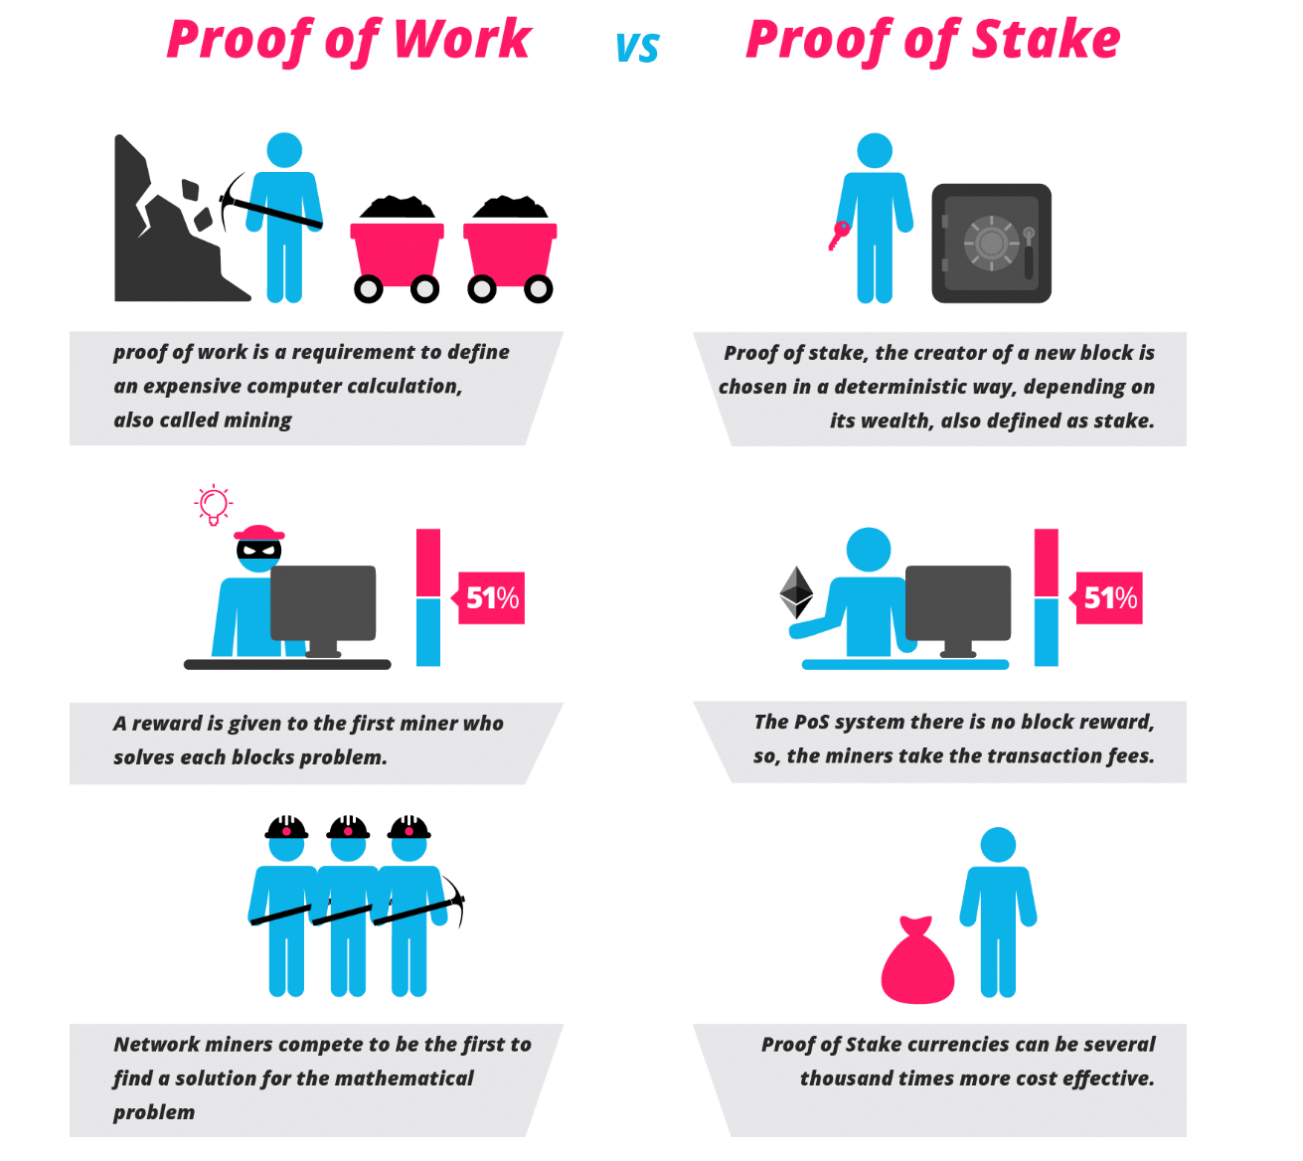
Concept used in Blockchain
Consensus Mechanism- A general agreement between all the nodes.
Can be achieved by -
Proof-of-work
Proof-of-state
Notes:
In centralized database system all the decisions are taken by a leader however, blockchain is a decentralized database system due to which it needs a different mechanism to take the decision so that they can come to a consensus that mechanism is called “Consensus Mechanism”.
Why we need this mechanism?
This mechanism is used to make sure that the block belongs to particular blockchain or not?
So how we can achieve this?
It can be achieved by two methods
Proof-of-work - The miners solve the cryptographic puzzles to mine a block in order to add to the blockchain. This process requires immense amount of energy and computation. The puzzle is created in such a way that it is hard to break. After solving the puzzle, miners present their blocks to the network for verification. If it is verified successfully then the block will be added into the chain. In this there is a reward for the miners who solves it first.
Proof-of-state - This method will make the entire mining process virtual and replace miners with validators. The validators have to lock up some of their coins as stack. After that, they will start validating the blocks. Meaning, when they discover a block which they think can be added to the chain, they will validate it by placing a bet on it. If the block gets appended, then the validators will get reward proportionate to their bets.

Slide 6
Difference between Relational and NoSQL
Relational Database
It does not allow adding data without defining schema
It was mainly designed to handle structured data.
It is expensive as it does not contain scaling property.
Relational database is a closed source with licensing fee
NoSQL
It allows to build an application without defining schema
It is designed to handle unstructured data
It is cheaper to scale a NoSQL database
It is a open source hence does not involve huge investment
Notes:
Data models: A NoSQL database let you build an application without having to define the schema first unlike relational databases which makes you define schema before you can add any data to the system. No predefined schema makes NoSQL database much easier to update as your data and requirements change.
Data Structure: Relational database were built in an era where data was fairly structured and clearly defined by their relationships. NoSQL are defined to handle unstructured data such as text, social media posts, video or emails
Scaling: It is much cheaper to scale a NoSQL database than the relational database because you can add capacity by scaling out over cheap servers. While relational database require a single server to host the entire database. To scale you need to buy a bigger server.
Development Model: NoSQL database are open source whereas relational dbs are closed source with fees.

Slide 7
Blockchain v/s Database
Regular databases are centralised. Using a client server architecture.
Blockchain is similar to distributed databases, i.e. with the objective of partitioning larger information retrieval and processing problems into smaller ones.
Multi-master modifications modifications are made to any copy of data and then sent to other- this is resolved in blockchain.
A smart contract is the same as stored procedures in centralised databases.
Blockchains allow permanent, immutable recordkeeping and are much slower than data stores designed to handle and distribute more perishable data.

Slide 8
Relational Database v/s blockchain
Relational databases have a decisive advantage when it comes to performance.
Blockchains have a decisive advantage when it comes to providing a robust, fault-tolerant, way to store critical data.
In a relational database, data can be easily modified or deleted. Single entity controls the data.
Distributed Ledgers (DL): Leverage cryptography to provide a decentralized multi-version concurrency control mechanism and to maintain consensus about the existence and status of shared facts in trustless environments
Byzantine-fault tolerant, pseudo-anonymity, auditability (public), immutability, accountability (time-stamping) and non-repudiation (signature) at transaction level.

Slide 9
Blockchain with Relational Database
Currently, bitcoin is using Flat file/Level DB to store and retrieve block information.
Bitcoin Architecture = BerkeleyDB (key/value) store + Flat file Database + LevelDB
Block in database is its Index Value (from Level DB) + Its data (stored in serialized format)
Advantages of using SQLite:
Memory reduction: Instead of storing and retrieving serialized and unserialized data, a relational database of tables is used to store information.Eliminate the need of leveldb
The use of SQLite make that the old system of storage of indices (in leveldb) will be eliminated.
The access time of data may be reduced by suppressing the module of serialization/unserialization.

Slide 10
A Comparison
 | Blockchain | Relational Database | Blockchain with Relational
Immutability | O |  | O
No Central Authority | O |  | O
Assets over Network | O |  | O
High Throughput |  | O | O
Low Latency |  | O | O
High Capacity |  | O (Expensive) | O (Expensive)
Schema less
Integrated Caching

Slide 11
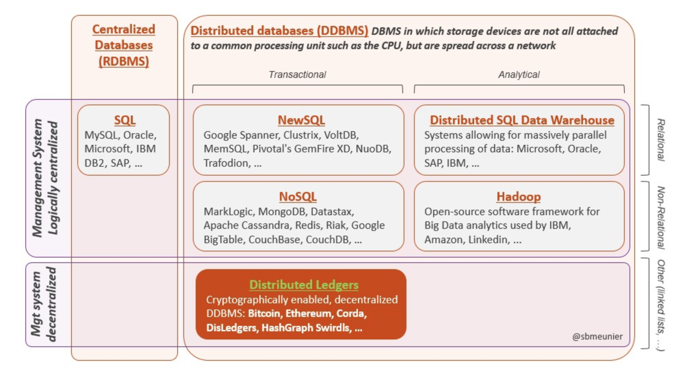
Where does blockchain fit?

Slide 12
Relation between blockchain and NoSQL
Few questions…
Why NoSQL to blockchain?
Schema-less
Partitioning
Unstructured
Query capabilities
How can NoSQL match blockchain?
Scalable by partitioning
Low latency
High performance
P2P with nodes permissions (Decentralized)
Immutability by ordering of transactions
Notes:
Schema-less : document, key-value pair, column, graph
Partitioning : nodes can contain part of data
-----------------
Low latency : schema less
High performance : unstructured data

Slide 13
Blockchain with NoSQL
 | BigChainDB
Description | Database-style decentralized storage Emphasis on scale Voting process between nodes provided decentralized control Tamper-resistance via ordering of blocks Improved performance
Applications | Database reliability Legal contracts and Certificates Supply chain Intellectual property
Notes:
BigChainDB
Combines both blockchain and database
Scalability is focused due to scaling problems in DB, by directly storing contracts and certificates
Tamper-resistance via ordered sequence of blocks maintaining sequence of transactions
Performance of subsecond latency, high throughput
Database reliability-no single point of failure

Slide 14
A Comparison
 | Blockchain | NoSQL | Blockchain with NoSQL
Immutability | O |  | O
No Central Authority | O |  | O
Assets over Network | O |  | O
High Throughput |  | O | O
Low Latency |  | O | O
High Capacity |  | O | O
Schema less |  | O | O
Integrated Caching |  | O | O
Notes:
Integrated caching : in-memory storage

Slide 15
References
Nakamoto, S., 2008. Bitcoin: A peer-to-peer electronic cash system.
Peters, G.W. and Panayi, E., 2016. Understanding modern banking ledgers through blockchain technologies: Future of transaction processing and smart contracts on the internet of money. In Banking Beyond Banks and Money (pp. 239-278). Springer, Cham.
Mbinkeu, R.C.N. and Batchakui, B., 2015. Reducing Disk Storage with SQLite into BitCoin Architecture. International Journal of Recent Contributions from Engineering, Science & IT (iJES), 3(2), pp.10-14.
McConaghy, Trent, Rodolphe Marques, Andreas Müller, Dimitri De Jonghe, Troy McConaghy, Greg McMullen, Ryan Henderson, Sylvain Bellemare, and Alberto Granzotto. "BigchainDB: a scalable blockchain database." white paper, BigChainDB (2016).
Gaetani, E., Aniello, L., Baldoni, R., Lombardi, F., Margheri, A. and Sassone, V., 2017. Blockchain-based database to ensure data integrity in cloud computing environments.

Slide 16


